Slide 1
Integration Testing: Bridging Unit and End-to-End Tests
Presented by,
Foumitha K P
Mtech Cse

Slide 2
Integration Testing
Integration testing is a software testing technique where individual units or modules are combined and tested as a group.
The goal is to verify how well these modules interact with each other and work together to form a functioning system.
It ensures smooth data flow and communication between components like frontend, backend, and database.
Acts as a bridge between unit testing and end-to-end testing.
Helps to detect interface mismatches, broken APIs, and integration errors early in development.
Commonly performed after unit testing and before system or user acceptance testing.

Slide 3
Types of Software Testing
Unit Testing – Tests individual functions in isolation. Eg: Testing a function that calculates the sum of two numbers.
Integration Testing – Tests interaction between modules. Eg: Submitting a form and verifying if the backend calculates the result correctly.
System Testing – Tests the entire system’s functionality. Eg: Checking if all features in the calculator app (UI + backend + result display) work together.
Acceptance Testing – Ensures the software meets user requirements. Eg: Client verifies that the calculator handles all expected operations before approving.
End-to-End Testing – Simulates complete user workflow. Eg: A user opens the site, enters numbers, clicks "Add", and sees the result.

Slide 4
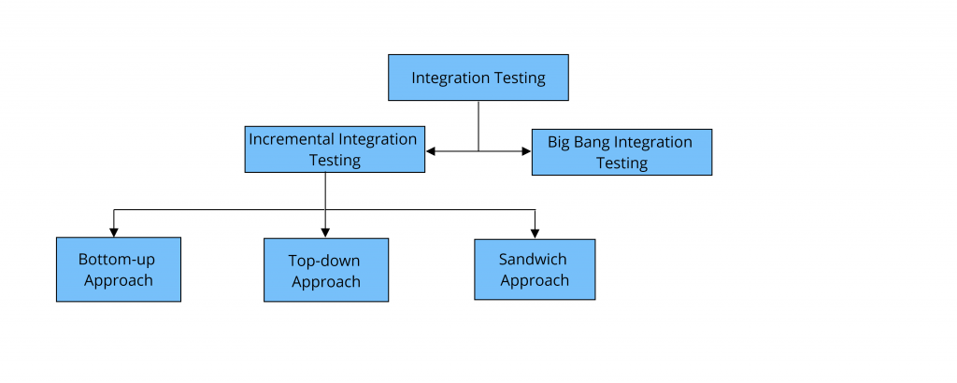
Types of Integration Testing

Slide 5
Types of Integration Testing
Incremental Integration Testing:
Integrate and test one module at a time, slowly build the full system.
Eg: First test addition feature, then subtraction, and so on, one by one.
Advantage: Easier to find bugs early.
It has three types:
Top-Down Integration
Bottom-Up Integration
Big Bang Integration

Slide 6
1.1. Top-down Integration Testing:
Start testing from the top (UI or main control module), then slowly integrate and test the lower-level modules.
Eg: First test your HTML form submission, then slowly connect it to backend /calculate route.
Use tools like stubs to simulate modules not yet ready.

Slide 7
1.2. Bottom-up Integration Testing:
Start testing from the lower-level modules (like backend logic), then add the UI later.
Eg: First test your Flask route logic that adds, subtracts, etc., then connect the HTML form.
Use tools like drivers to simulate input from upper modules.

Slide 8
1.2. Sandwich Integration Testing:
Combine both Top-Down and Bottom-Up, test from both ends and meet in the middle.
Eg: Test the frontend and backend in parallel, then connect both in the middle layer.
Multiple teams work on different parts at the same time.

Slide 9
2. Big Bang Integration Testing
All the modules (frontend, backend, database) are developed first and then tested all together at once.
Eg: You complete the HTML form, the Flask backend, and all calculations, then test everything together.
Advantage: Fast to implement.
Disadvantage: If an error occurs, it’s hard to find where it happened.

Slide 10
Tools for Integration Testing
Pytest: Unit & Integration test framework in Python
Cypress: API testing and end-to-end testing for frontend/backend
Selenium: UI automation testing
BrowserStack: For testing the UI across multiple browsers and devices.

Slide 11
Integration Testing on Flask Calculator App Using Pytest, Cypress, Selenium & BrowserStack

Slide 12
Demo: Test Suite Components
Flask App: Calculator logic & routes.
pytest: For JSON-based API endpoint tests.
Cypress: For testing API + UI flow.
Selenium: For browser-based form automation.
BrowserStack: For real device testing.
Each file/module: app.py (Flask app), test_api.py (pytest), cypress/integration/calc_spec.js, selenium_test.py, and browserstack_test.py

Slide 13
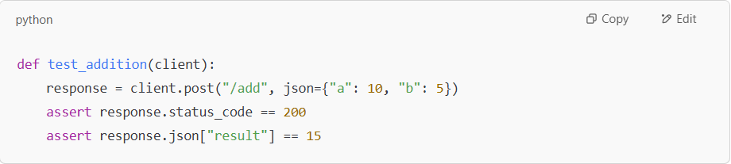
Sample Pytest Integration Test
The test sends a POST request to the /add route.
It includes two numbers in JSON format (like {"a": 5, "b": 3}).
The Flask app processes this data and returns the sum.
The test checks if the response is correct (in this case, 8).
Similar tests are written for subtract, multiply, and divide operations.

Slide 14
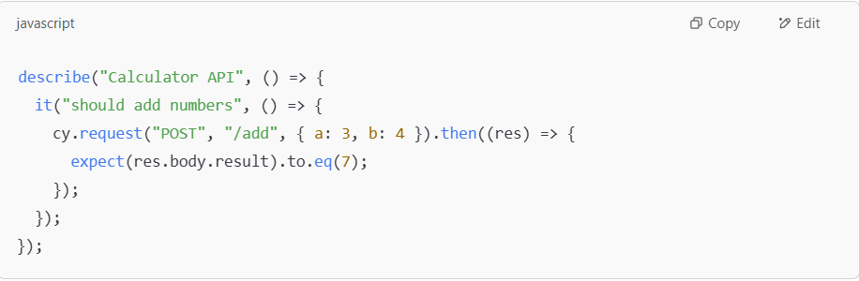
Sample Cypress Test
Cypress test sends a request to our Flask API (like /add).
It checks if the result is correct (e.g., 5 + 3 = 8).
This shows how Cypress can be used for API testing.
Cypress can also do UI testing by using cy.visit() to open the page.
Then it can click buttons and fill forms just like a real user.

Slide 15
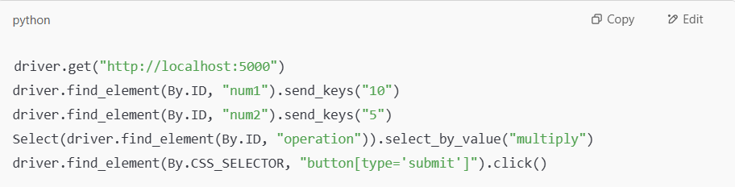
Selenium UI Test Example
This script uses Selenium to open the calculator webpage.
It fills the form with two numbers and selects an operation (like multiply).
Then it clicks the Calculate button like a real user.
It checks if the correct result is shown on the page.
This confirms that the form and backend are working together properly.

Slide 16
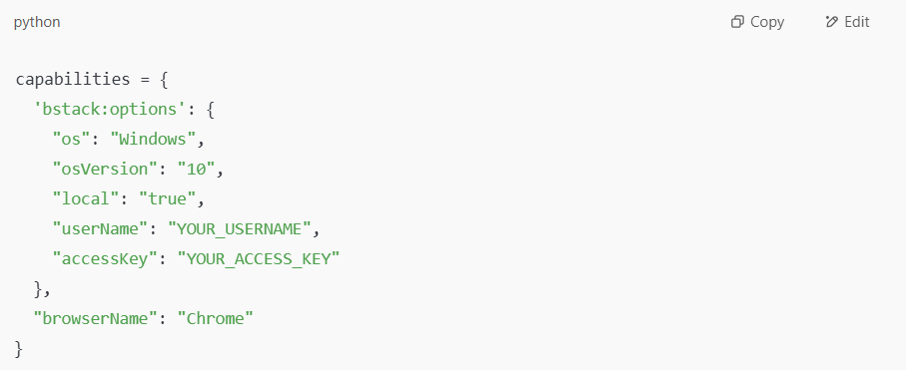
BrowserStack Cross-Browser Test
This test uses BrowserStack to run on a cloud machine (not your computer).
It opens your calculator app in a real browser like Chrome or Safari on that machine.
Then it fills the form and checks the result, just like the Selenium test.
This helps you make sure the app works on different browsers and systems.
You can also test on Mac, iPhones, Android phones, etc., using BrowserStack.

Slide 17
CONCLUSION
Integration testing ensures that different components of a system work together correctly.
Even simple applications benefit from automated and structured integration testing.
Pytest is effective for verifying backend logic and API responses.
Cypress and Selenium provide powerful automation for both API and UI workflows.
BrowserStack supports testing across various browsers and devices for compatibility.

Slide 18
THANK YOU

